Slide 1


A* Algorithm
Scan me! →
To attend
Scan me! →
To attend
Start!

Slide 2

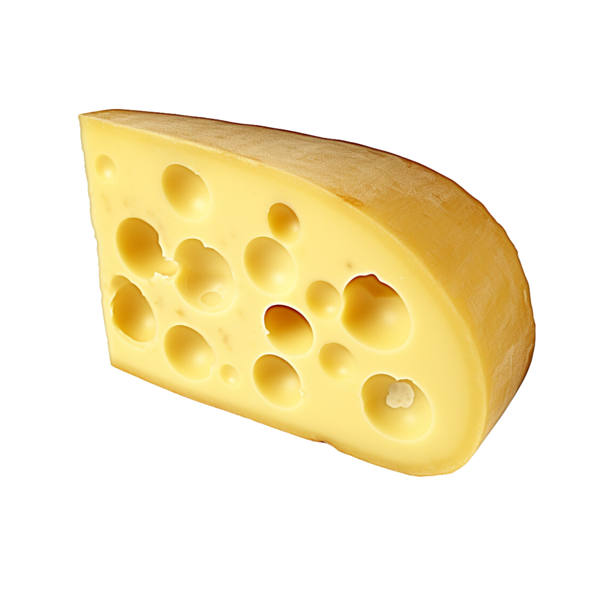
Story Time!!!
1.
Mikkel the mouse is trying to hide from some house cats that are chasing him after trying to steal the cheese from the kitchen pantry.
He narrowly escapes but will go hungry soon if he doesn’t get enough cheese.
Luckily, he has a robot that can help him navigate the house to get to the cheese by finding the shortest-path from his position to the pantry.

Slide 3
“Search algorithms allow AI systems to solve complex problems efficiently by exploring vast solution spaces. They enable machines to find optimal or near-optimal solutions, leading to improved decision-making, planning, optimization, and problem-solving in a wide range of real-life scenarios.”
The Medium (<- link to read more)
Back
Next

Slide 4
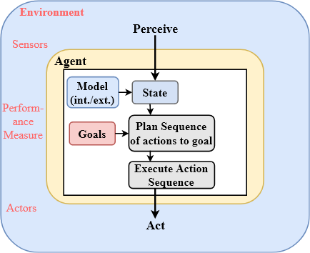
Preface
Agents: Virtual Robots with functions
Pathfinding Algorithms: Algorithms that search for the best way to travel from one place to another.
Estimations
Back
Next

Slide 5
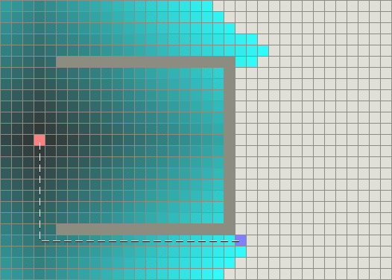
Pathfinding Procedures
2.
Imagine a robot trying to find its way out of a room with a large obstacle in front of it that curves inward, creating two possible paths around it.
A basic algorithm, like Dijkstra's, would make the robot explore both paths around the obstacle.
It would figure out which path has the lowest "cost" (meaning the shortest or easiest way) to reach the exit from the starting point.
Back
Next

Slide 6
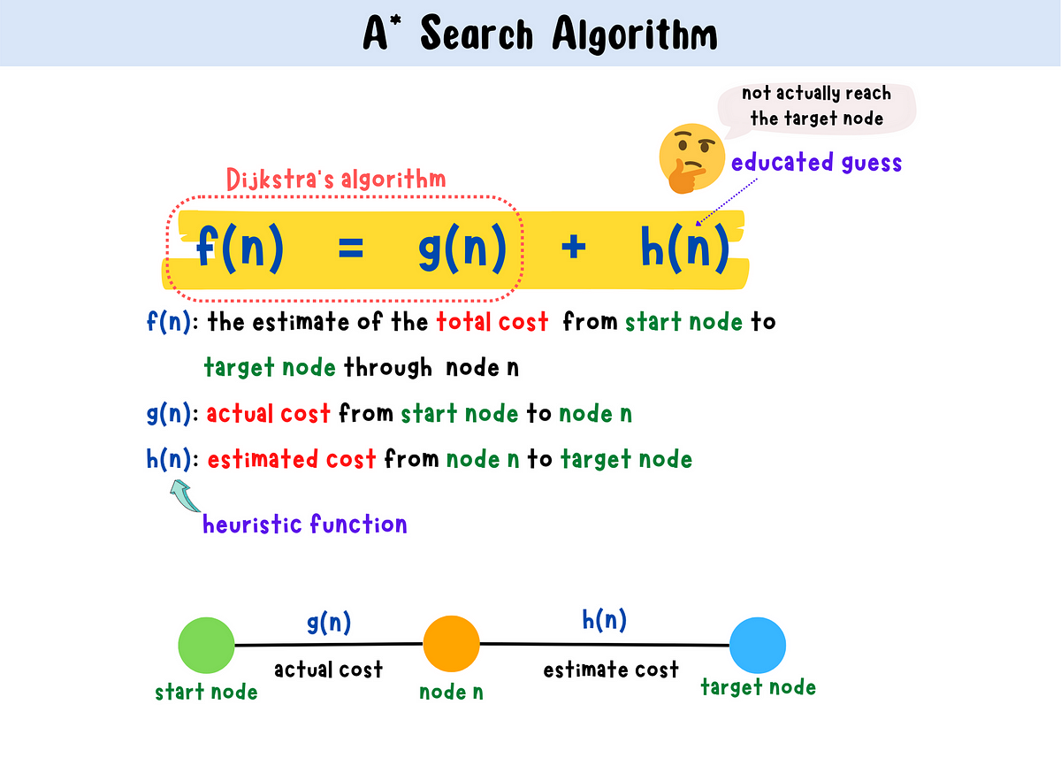
What is the A* algorithm?
A pathfinding algorithm that reduces the time it takes in finding the shortest path by checking how far you traveled, and how far you need to go to reach your destination.
It executes this through the use of heuristics.
Video
Back
Next

Slide 7
Heuristics?
Heuristics are an additional variable to a search function separate from the lowest cost function that we see in Dijkstra’s algorithm.
This is an estimated cost of the shortest path from the destination to the agent’s current position.
We take advantage of the use of Manhattan distances in this algorithm.
* Manhattan Distances: the distance between two points in a grid-based system where you can only move horizontally or vertically, not diagonally.
Back
Next

Slide 8

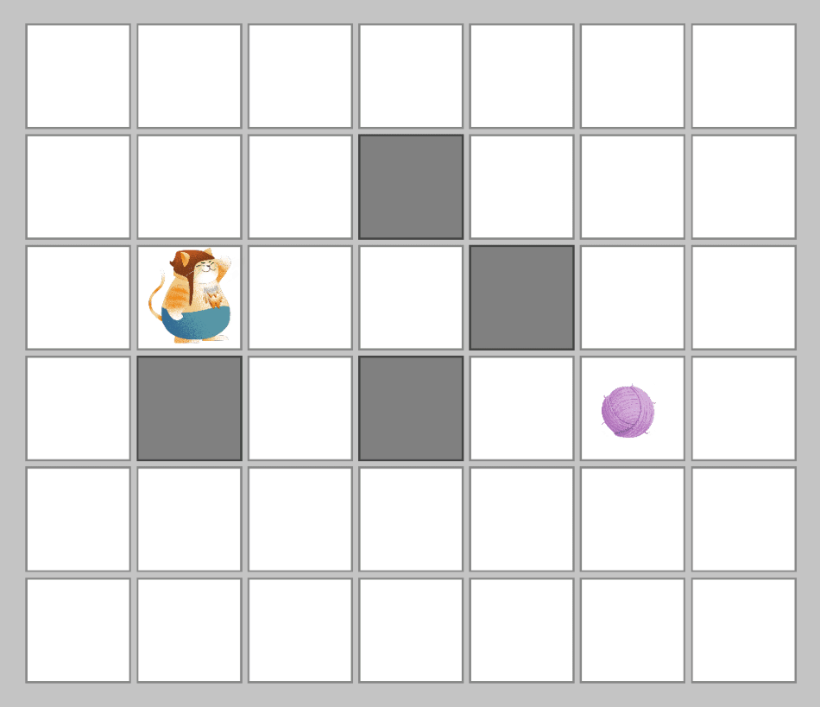
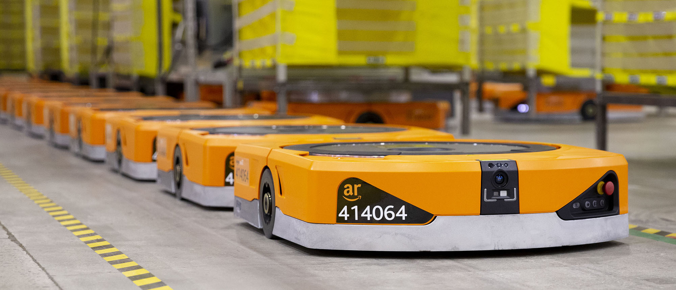
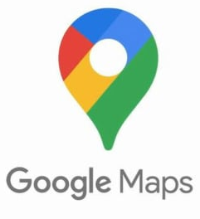
Use Cases
3.
NPC pathfinding
Logistics Optimizations (Mail carrier services, food delivery)
Warehouse Navigation systems (Amazon)

Slide 9
Questions?

Slide 10
Credits
Content: Santiago Martinez
With help from: Medhasri Veldurthi, Maya Kalapatapu, Maureen Pan, Tirth Shah

Slide 11
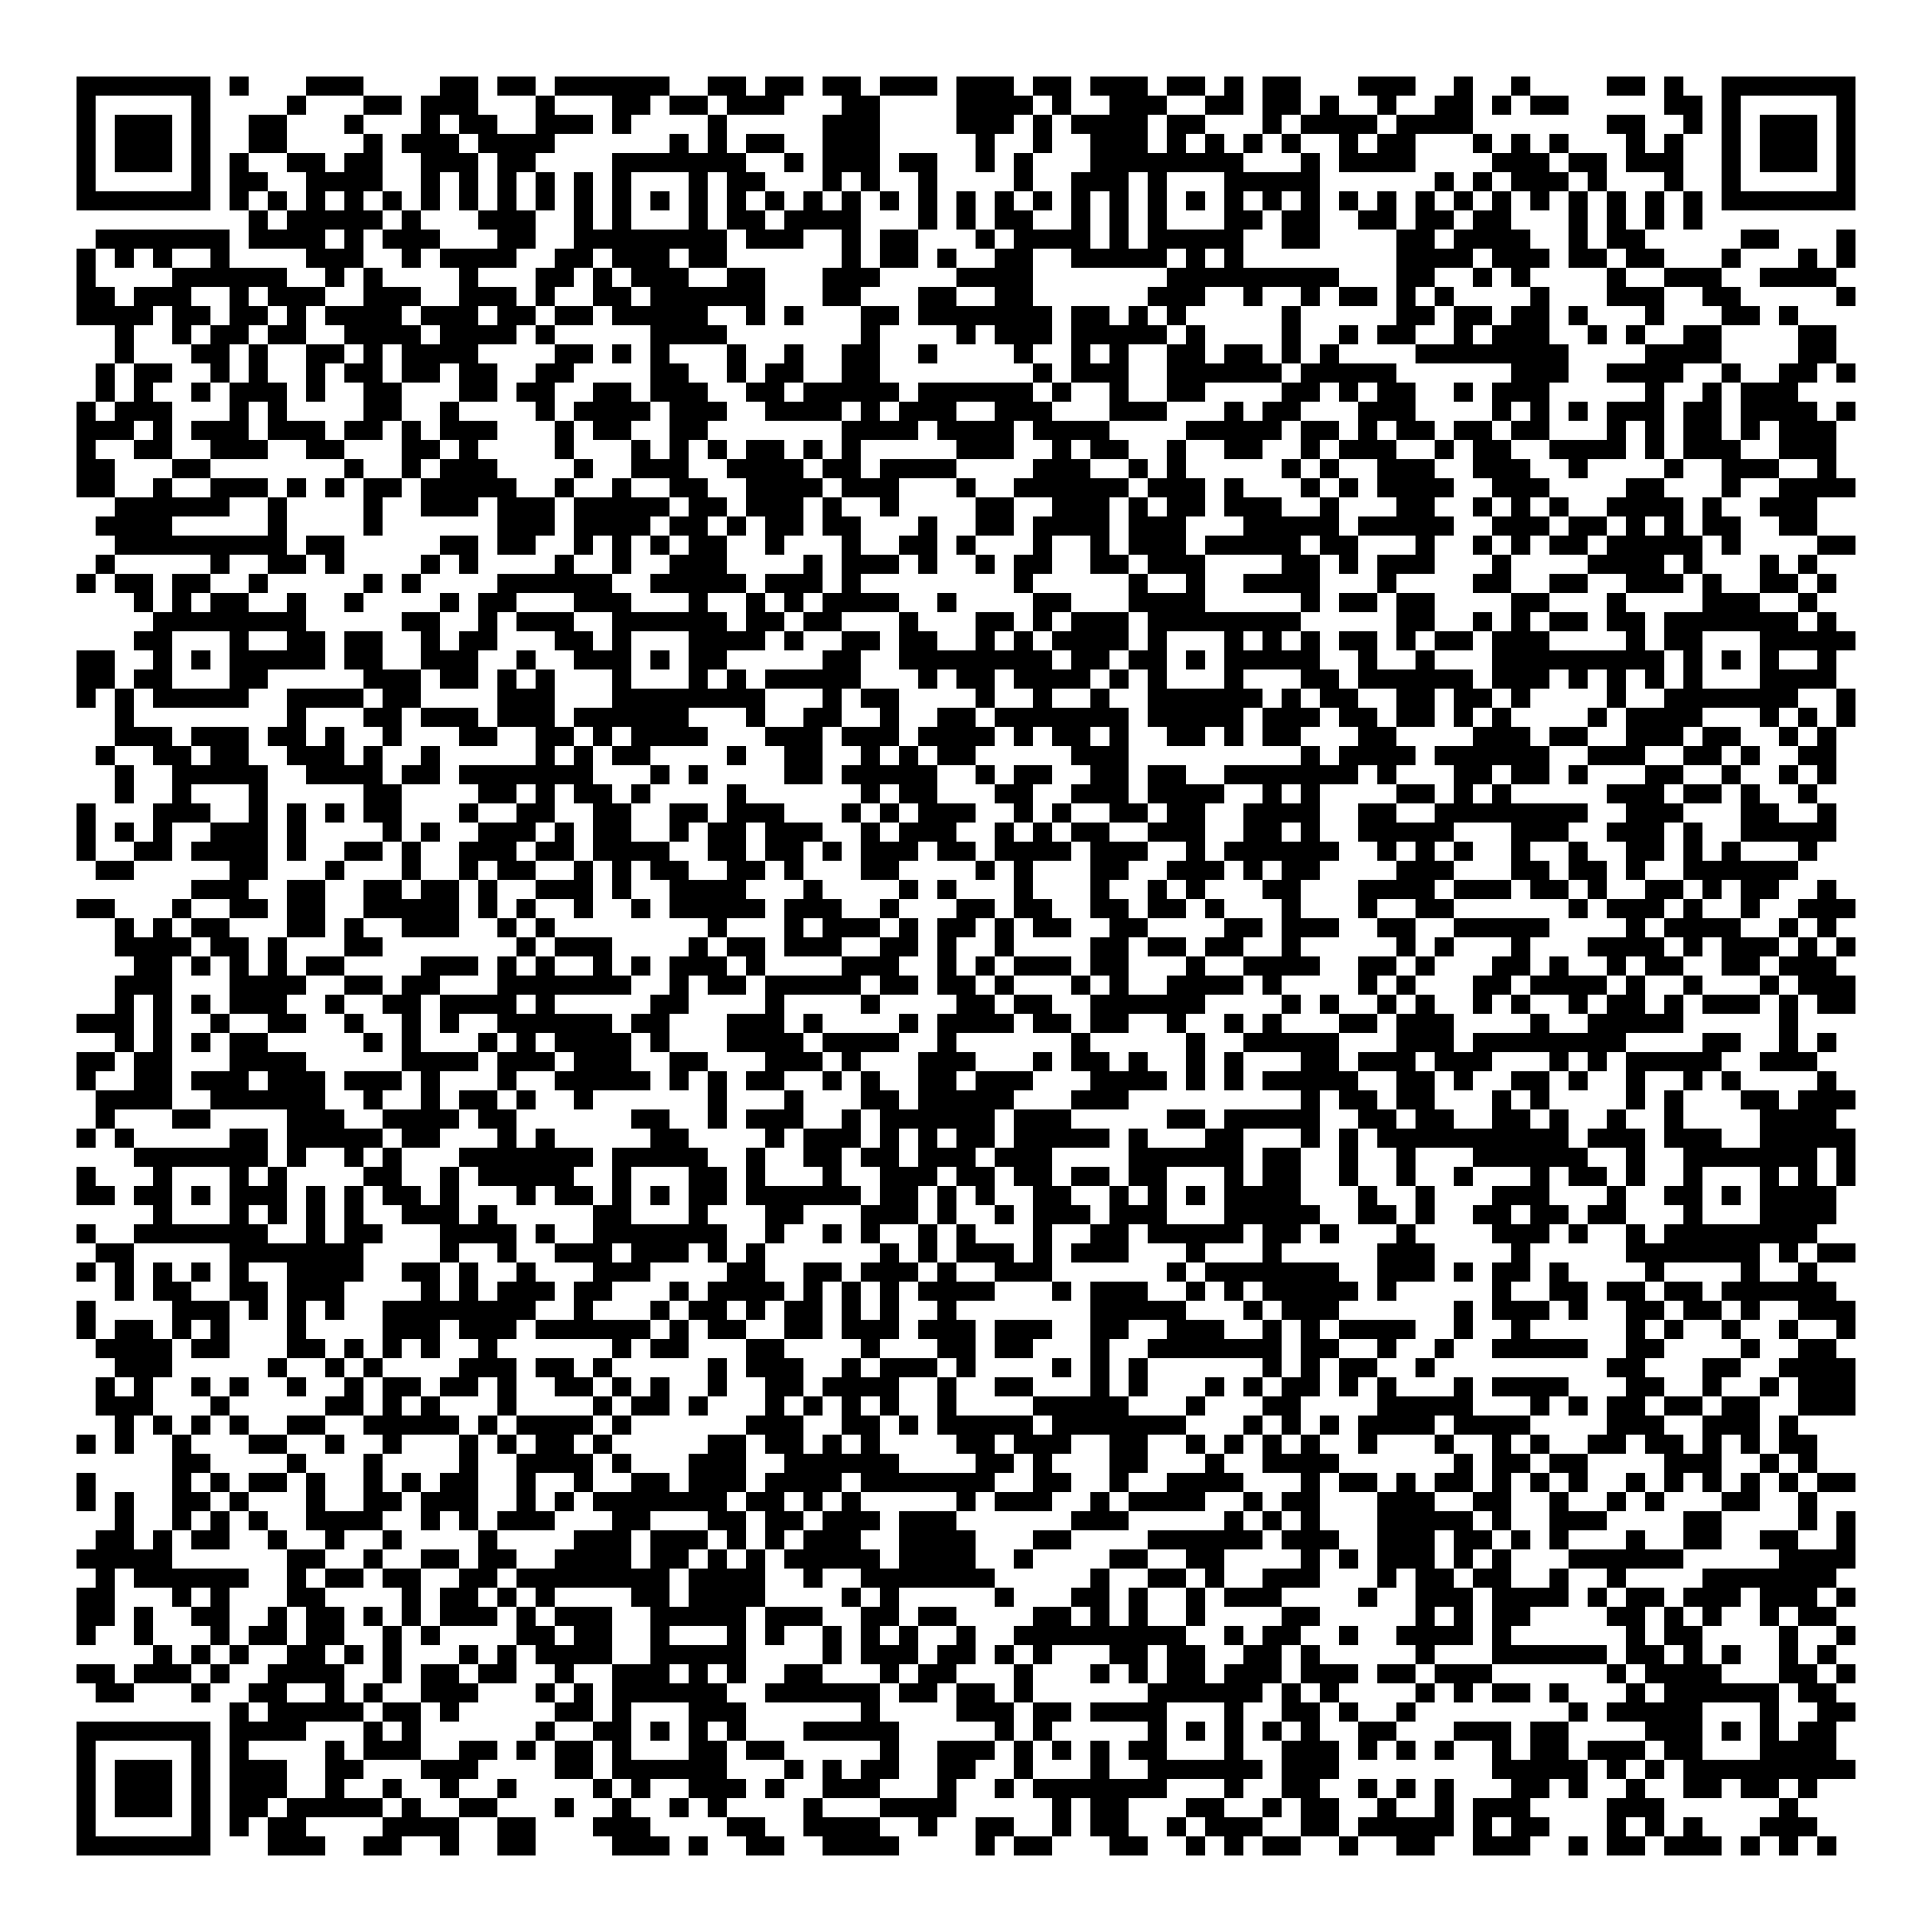


Thanks for coming!
Next Meeting: 10/21 with Troy Tutors & pizzaaaa

